Slide 1
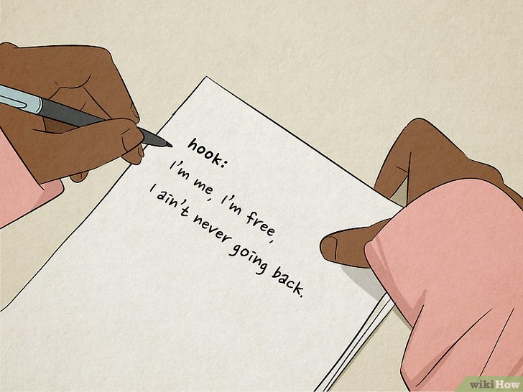
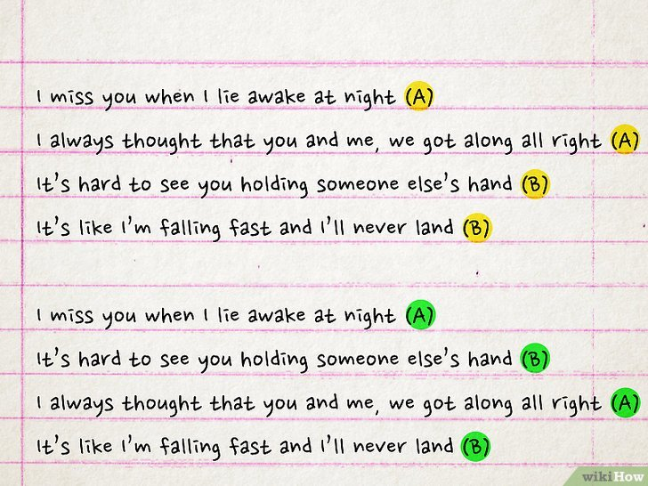
Evaluating Language Models on Hip Hop Lyric Generation
Ryan Farhat-Sabet, Moonsoo Kim, Joseph Uren
Notes:
https://www.wikihow.com/Write-Rap-Lyrics

Slide 2
Motivation & Goal
Lyrics are a creative and complex form of language, and hip-hop songs pose particular challenges:
Rhyme
Rhythm
Slang
Metaphor
Unconventional grammar
Goal: Build a model that generates the next line of hip-hop lyrics
Notes:
Moonsoo
Notes:
Lyrics are a creative and complex form of language
Hip-hop lyrics are especially challenging:
Rhyme, rhythm, slang, metaphors, unconventional grammar
Goal: Generate the next line of hip-hop lyrics
Identify which model architecture and input strategy works best

Slide 3
Background
Previous research with generation tasks of all kinds:
Different domains: poetry, songwriting, hip hop
Different models: decoder-only, encoder-decoder
Different inputs: melody, song structure, rhyme patterns
Notes:
Moonsoo
Notes:

Slide 4
Models Evaluated
Decoder-only models: GPT-2, Llama-3.2
Strength: handle long prompts well
Weakness: no bidirectional context
Encoder-decoder model: FLAN-T5
Strength: bidirectional attention, instruction-tuned
Weakness: more computationally expensive
Notes:
Moonsoo
Notes:
Decoder-only models: GPT-2, Llama-3.2
Strength: handle long prompts well
Weakness: no bidirectional context
Encoder-decoder model: FLAN-T5
Strength: bidirectional attention, instruction-tuned
Weakness: more computationally expensive
Fine-tuned all models on filtered Genius rap lyrics dataset

Slide 5
Task & Dataset
Task: Given a previous line → generate a plausible next line
Dataset:
5M+ Genius lyrics → filtered for mainstream rap
Cleaned, removed tags & credits
Formed line pairs for supervised next-line generation
Final dataset: 60K train pairs, 15K val pairs, 15K test pairs
Notes:
Joe
Notes:
Task: Given up to 3 previous lines → generate a plausible next line
Dataset:
5M+ Genius lyrics → filtered for mainstream rap
Cleaned, removed tags & credits
Formed line pairs for supervised next-line generation
Fine-tuned all models on filtered Genius rap lyrics dataset

Slide 6
Evaluation Metrics
Content overlap: BLEU, ROUGE (1/2/L)
Semantic similarity: BERTScore, SBERT cosine similarity
Style constraints:
Rhyme rate (CMU dictionary phoneme matching)
Syllable similarity (line length match)
Word diversity (unique words percentage)
Notes:
Joe
Notes:
Content overlap: BLEU, ROUGE
Semantic similarity: BERTScore, SBERT cosine similarity
Style constraints:
Rhyme rate (CMU dictionary phoneme matching)
Syllable similarity (line length match)
Word diversity (avoid repetition)

Slide 7
Experiments (part 1)
Baseline: GPT-2
Testing different models:
Llama-3.2
FLAN-T5
Testing different setups:
Pre-training on training data
Fine-tuning different layers
Prompt engineering
Notes:
Ryan
Notes:
(Why and what we thought might happen)
Baseline: GPT-2, Llama-3.2, FLAN-T5 fine-tuned - different models as a baseline, llama is close to current state of the art; test them all with pretrainin and finetuning as a benchmark
Prompt engineering to see if prompting it any differently improves generation results
Can use the initial results from these experiments to inform our next experiments

Slide 8
Experiments (part 2)
Testing different inputs:
Extra rhyme layer
Syllable-aware layer with prefix
Additional input lines
Backwards generation
Notes:
Ryan
Notes:
FLAN-T5 additional experiments:
Extra rhyme & syllable-aware layers
Rhyme layer in decoder to try and teach output to rhyme on last word
syllables as prefix so model can learn to predict the correct length
Additional input lines (context window)
More context, 3 lines instead of 1, hopefully improve flow and capture more info about the structure of the song
Backwards generation
Flip input line and then generate output backwards (right to left); easier for the model to attend to the last word of the input

Slide 9
Results
Experiment | BLEU | ROUGE-1 | ROUGE-2 | ROUGE-L | BERT | SBERT | Rhyme Rate | Syllable Similarity | Word Diversity
GPT2 Baseline | 0.0063 | 0.08 | 0.009 | 0.07 | 0.8177 | 0.1523 | 3.04% | 16.37 | 0.863
DistilGPT Baseline | 0.0071 | 0.0735 | 0.0105 | 0.0661 | 0.7985 | 0.1616 | 4.60% | 13.5 | 0.824
Llama-3.2 Baseline | 0.0065 | 0.076 | 0.0127 | 0.0699 | 0.8172 | 0.1792 | 1% | 11.52 | 0.318
FLAN-T5 Baseline | 0.0177 | 0.1006 | 0.032 | 0.0963 | 0.8282 | 0.2053 | 43.77% | 4.95 | 0.951
GPT-2 Pre-Training | 0.0156 | 0.1027 | 0.0262 | 0.0954 | 0.8262 | 0.2038 | 12.71% | 6.34 | 0.724
Llama-3.2 Pre-Training | 0.0089 | 0.084 | 0.016 | 0.079 | 0.8212 | 0.2014 | 1% | 8.2 | 0.366
FLAN-T5 Pre-Training | 0.0252 | 0.1149 | 0.0358 | 0.109 | 0.8354 | 0.2142 | 30.96% | 3.84 | 0.913
GPT-2 Fine-tuning | 0.0158 | 0.1035 | 0.0262 | 0.0967 | 0.8268 | 0.2065 | 13.20% | 6.28 | 0.712
Llama-3.2Fine-tuning | 0.0089 | 0.084 | 0.016 | 0.079 | 0.8212 | 0.2014 | 1% | 8.2 | 0.366
FLAN-T5 Fine-tuning | 0.0298 | 0.1239 | 0.0425 | 0.118 | 0.8366 | 0.2248 | 38.45 | 3.77 | 0.883
GPT2 Prompt Engineering | 0.0268 | 0.0909 | 0.0365 | 0.0899 | 0.8166 | 0.2378 | 5% | 10.51 | 0.14
FLAN-T5 Rhyme Layer | 0.003 | 0.0354 | 0.0043 | 0.0344 | 0.7966 | 0.1297 | 32.62% | 13.13 | 0.795
FLAN-T5 Syllable Layer | 0.0264 | 0.1184 | 0.0376 | 0.1123 | 0.836 | 0.2185 | 34.91% | 3.76 | 0.91
FLAN-T5 3-line Input | 0.0323 | 0.1277 | 0.0452 | 0.1213 | 0.8375 | 0.2265 | 23.06 | 3.79 | 0.91
FLAN-T5 Backward Generation | 0.0324 | 0.1251 | 0.0463 | 0.1193 | 0.8324 | 0.2341 | 42.34% | 3.66 | 0.902
Notes:
Ryan
Notes:
FLAN-T5 outperformed GPT-2 and Llama-3.2, both on a baseline level and once fine-tuned (encoder-decoder architecture was able to learn more from the input once added on account of the bidirectional attention; FLAN was already trained on a similar generation task); rhyme rate did decrease though, but that was on account of it using different words and generating more creative responses instead of the same input line/same word over and over
Prompt engineering didn’t improve the model as much as expected (really only helpful for decoder-only models, but extra specificity didn’t help as much as we thought)
Rhyme and syllable experiments were somewhat helpful but not the most impactful (helped certain metrics but hurt others)
Adding context lines improved coherence and flow
Backwards generation boosted rhyme and syllable alignment (didn’t always make grammatical sense though)

Slide 10
Results
FLAN-T5 outperformed GPT-2 and Llama-3.2, both on a baseline level and once fine-tuned
Prompt engineering didn’t improve the model as much as expected
Adding context lines improved coherence and flow
Backwards generation boosted rhyme and syllable alignment
Notes:
Ryan
Notes:

Slide 11
Conclusion & Future Work
Best setup: Fine-tuned FLAN-T5 with 3-line input or backwards generation
Encoder-decoder models with bidirectional attention were more effective for this style of creative, stylistic generation
Future directions:
Incorporate beat/melody features
Improve slang and metaphor handling
Combine input layer experiments
Notes:
Ryan
Notes:
Best setup: Fine-tuned FLAN-T5 with enhanced input strategy
Encoder-decoder models can outperform decoder-only in creative domains
Future directions:
Incorporate beat/melody features
Improve slang and metaphor handling
Explore reinforcement learning with human feedback

